Slide 1

Branch - CSE Python Programming
Lecture – 12 List
By
Dr. Smita Tiwari
Assistant Professor
Department of Computer Science and Engineering
School of Engineering & Technology

Slide 2
What is a List in Python?
Lists are a type of built-in data structure in Python, which is a specified way of storing and formatting data.
Python lists can store an ordered collection of items, or elements, of varying types.
They are often used to compile multiple items into a single, mutable variable, which is helpful for retrieving items, specifying outputs or performing calculations quickly.
A Python list is a dynamic, mutable, ordered collection of elements enclosed within square brackets [].
The elements of the list, called items or values, can be of different data types – numbers, strings, booleans, and even other lists (creating nested structures).

Slide 3
Features of Lists in Python
All Python lists include the following features or characteristics:
Lists can contain items of different types at the same time (including strings, integers, floating point numbers and boolean values).
Lists are mutable and dynamic; list items can be added, removed or changed after the list is defined.
Lists are ordered; newly added items will be placed at the end of the list.
Lists use zero-based indexing; every list item has an associated index, and the first item’s index is 0.
Duplicated list items are allowed.
Lists can be nested within other lists indefinitely.

Slide 4
How to create a list in Python?
To create a list in Python, write a set of items within square brackets ([]) and separate each item with a comma.
Items in a list can be any basic object type found in Python, including integers, strings, floating point values or boolean values.
Single line list
Mixed data type list
Multi-line list for readability
numbers = [
1,
2,
3,
4,
5,
]
fruits = ["apple", "banana", "cherry"]
mixed_list = ["hello", 3.14, True]

Slide 5
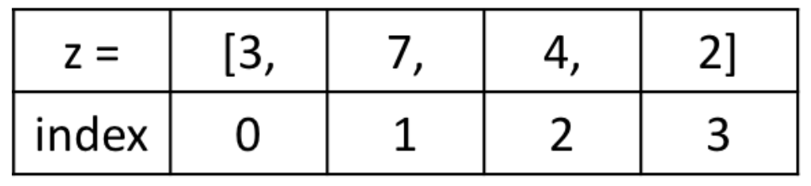
How to Access Elements in a List in Python?
Each item in a list has an assigned index value.
Python is a zero-indexed based language. This means is that the first item in the list starts at index 0 and ascends accordingly.
In the example list, “z,” the indices of each list item would look like this:

Slide 6
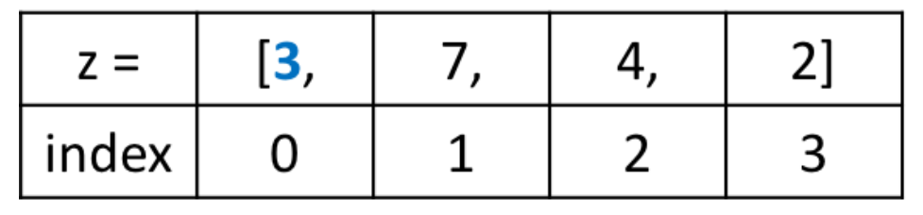
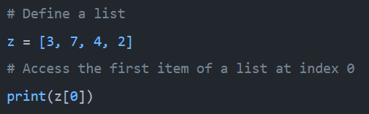
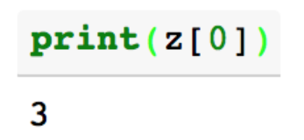
How to Access Elements in a List in Python?
To access an item value, print the index of the associated item in the list.
As an example, to access the first item from the list “z,” shown in blue below:
To access item 3, use the item’s index, 0, and write:

Slide 7
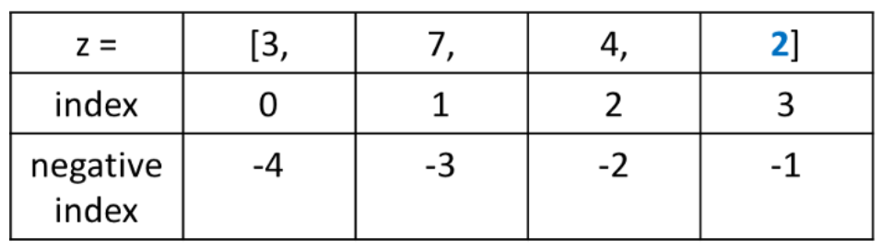
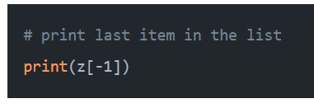
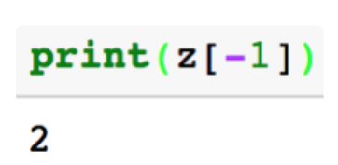
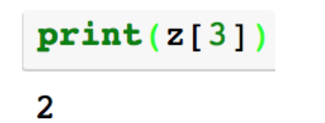
How to Access Elements in a List in Python?
Python also supports negative indexing.
Negative indexing starts at the end.
It can be more convenient at times to use negative indexing to get the last item in the list because we don’t have to know the length of the list to access the last item.
We can also access the same item using positive indexes, as below.

Slide 8
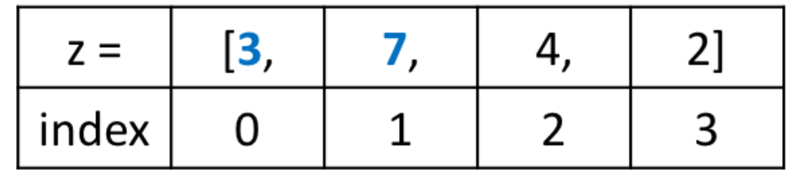
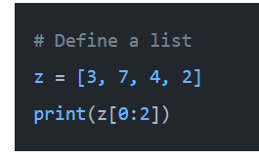
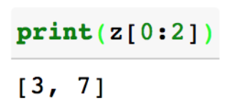
How to Slice a Python List
Slices are good for getting a subset of values in a list.
If we want to access a range, we need the index that will slice the portion from the string.
For an example, below code will return a list with the items from index 0 up to and not including index 2.

Slide 9
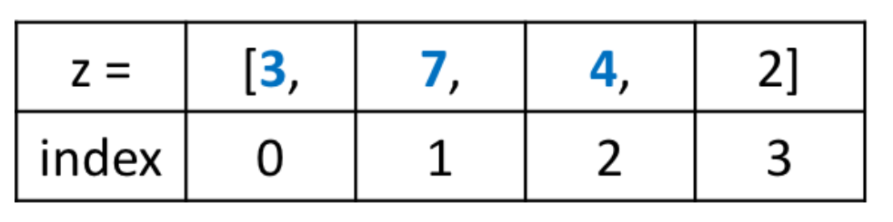
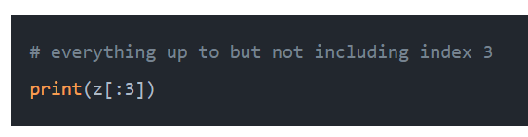
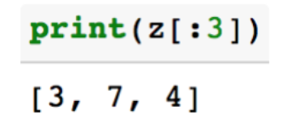
How to Slice a Python List

Slide 10
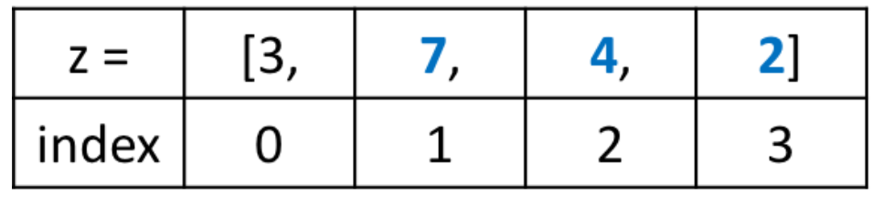
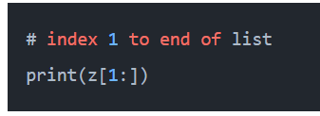
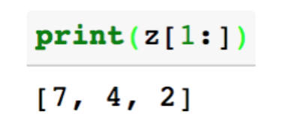
How to Slice a Python List
Returns a list with items from index 1 to the end of the list

Slide 11
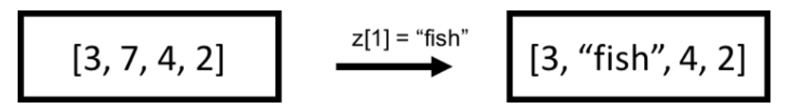
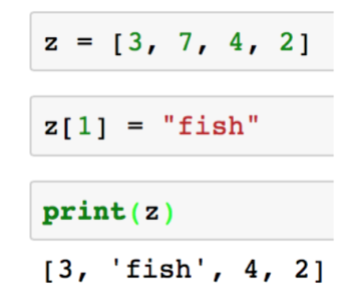
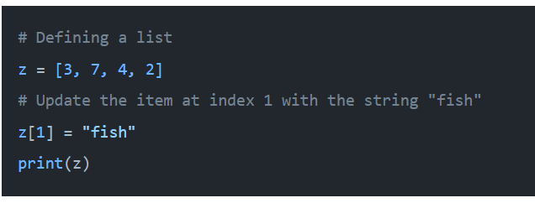
How to Update an Item in a Python List
Lists in Python are mutable. After defining a list, it’s possible to update the individual items in a list.

Slide 12
Python List Modification Methods
Eight Ways to Modify a Python List
Index method
Count method
Sort method
Append method
Remove method
Pop method
Extend method
Insert method

Slide 13
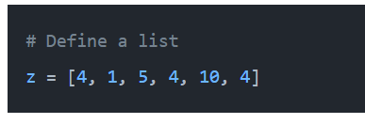
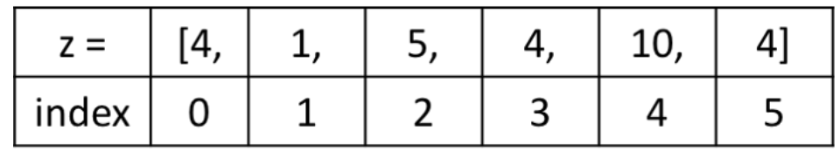
Python List Modification Methods
Python lists have different methods that help us to modify a list.
1. Index Method
The index method returns the first index at which a value occurs.
Example: To get the index of the first occurrence of “4” in following list:

Slide 14
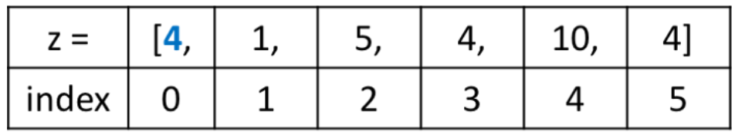

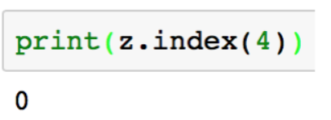
Python List Modification Methods
1. Index Method
Example: To get the index of the first occurrence of “4” in following list:
In the code below, using index() will return 0.

Slide 15
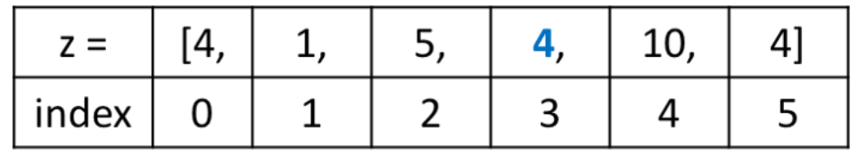

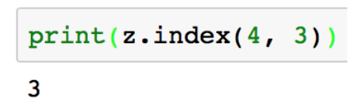
Python List Modification Methods
1. Index Method
We can also specify where we want to start our search if there are multiple of the same list item.

Slide 16
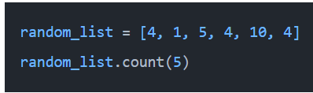
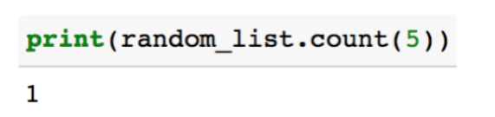
Python List Modification Methods
2. Count Method
The count method counts the number of times a value occurs in a list.

Slide 17
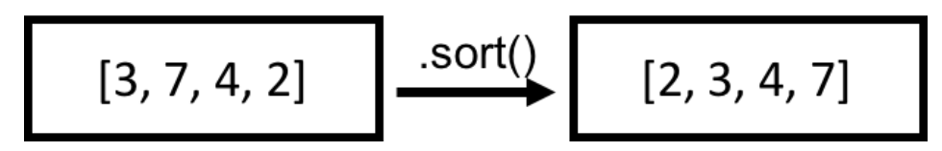
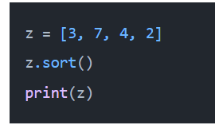
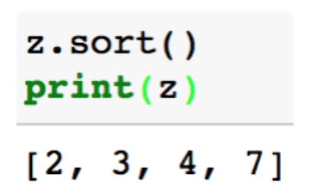
Python List Modification Methods
3. Sort Method
The sort method sorts and alters the original list in place.

Slide 18
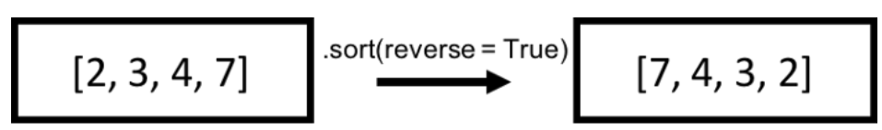
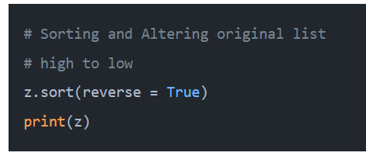
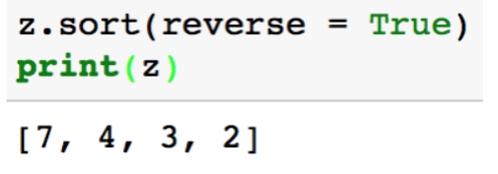
Python List Modification Methods
3. Sort Method
The code in previous slide sorts a list from low to high.
The code below shows that you can also sort a list from high to low.

Slide 19
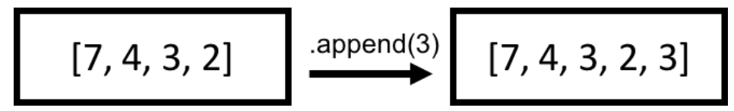
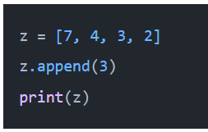
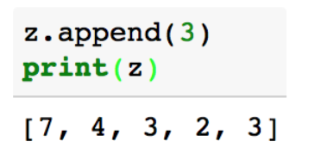
Python List Modification Methods
4. Append Method
The append method adds an element to the end of a list. This happens in place.

Slide 20
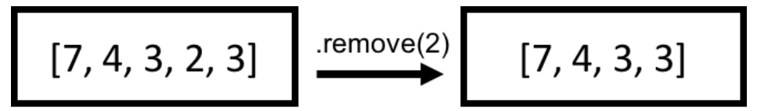
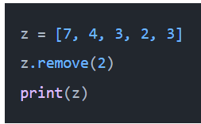
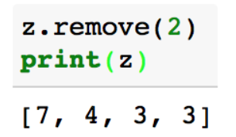
Python List Modification Methods
5. Remove Method
The remove method removes the first occurrence of a value in a list.
Code removes the first occurrence of the value 2 from the list z.

Slide 21
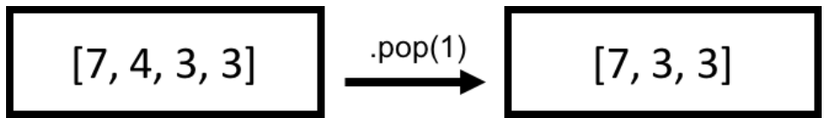
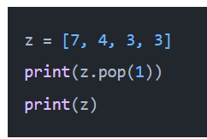
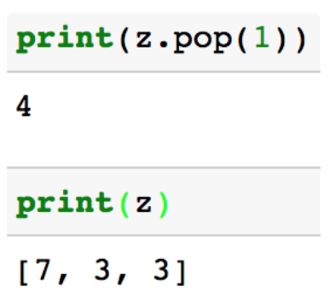
Python List Modification Methods
6. Pop Method
The pop method removes an item at the index we provide.
This method will also return the item removed from the list.
If an index is not provided, it will default to removing the item at the last index.

Slide 22
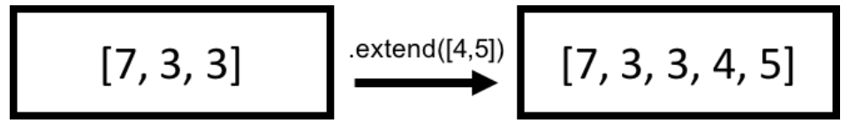
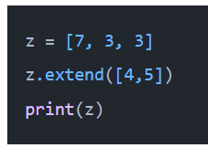
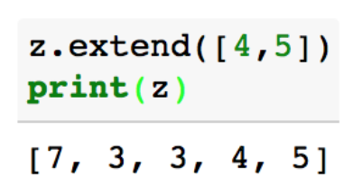

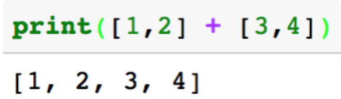
Python List Modification Methods
7. Extend Method
Extend method extends a list by appending items.
The benefit of this method is that we can add lists together.
Alternatively, the same thing could be accomplished by using the + operator.

Slide 23
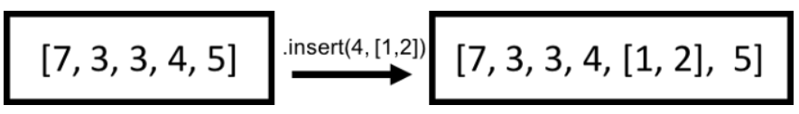
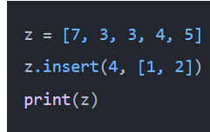
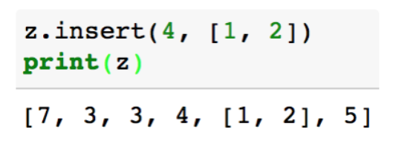
Python List Modification Methods
8. Insert Method
The insert method inserts an item before the index we provide.

Slide 24
THANK YOU

